Slide 1


Collaboration is key:
Responding to researcher’s needs in the COVID-19 pandemic
Alle Bloom, UK Data Service
Copyright © 2024 University of Manchester. Created by Cathie Marsh Institute, UK Data Service.
Notes:
Photo by 🇸🇮 Janko Ferlič on Unsplash

Slide 2
This talk
User support and training team
Prior to COVID-19 pandemic
  Support for researchers
  Collaboration
Our response to COVID-19
  Events
  Resources
Summary: Key lessons

Slide 3
User support and training team
Help equip users with the skills to find, access and get started with the data
Users from a wide variety of backgrounds

Slide 4
Support for researchers prior to COVID-19

Slide 5
Support prior to COVID-19
Provide training in the form of webinars, workshops, interactive online resources, guides and conferences
Helpdesk support
Collaboration was a key part of this

Slide 6





Collaboration prior to COVID-19
Collaboration at a local and international level has always been a part of how we deliver training.
For example:
Data Resources and Training Network (DRTN)
National Centre for Research Methods (NCRM)
CESSDA
Q-Step
Government departments (ONS)
Data providers

Slide 7
Our response to COVID-19

Slide 8

Overview
Events
Resources

Slide 9

Events: User conferences
Moved to online in the context of pandemic restrictions
Health Studies User Conference 2020
  Collaboration with NatCen and UCL
  One of the first online conferences
  Big risk but hugely successful
    Over double the numbers of attendance when in person (200+)
    Wide reach overseas – Australia!
Made possible because of our existing network and previous experience with collaborating organisations
Some have returned to in person, some remained online

Slide 10
CESSDA Roadshows – COVID-19 and Cancer and Major Chronic Disease
Collaborated with other CESSDA service providers on two roadshow events:
COVID-19:
  Worked with CESSDA , AUSSDA and DANS to organise a practical deep dive into COVID-19 data
  Highlighted the available COVID-19 data and how to find this
Cancer and Major Chronic Disease
  Worked with NSD and UCL and UoM
  Provided our expertise on discovery at national and European levels
Utilised our knowledge of data discovery to bring training expertise to an international audience
Utilised our networks to bring in expert researchers for these events

Slide 11
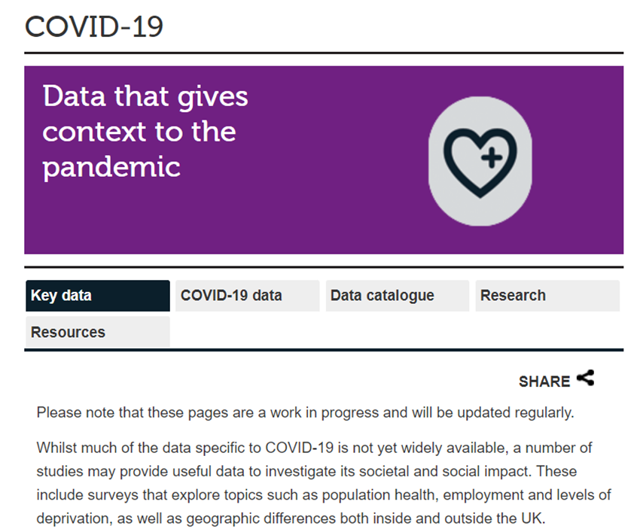

Resources: COVID-19 Theme page
Central hub for COVID-19 data, resources and case studies.
Initially started with ‘Key data’ from existing surveys measuring topics such as poverty, pre-existing health conditions, working patterns
Co-ordinated with data providers to discuss when next datasets would be available
Also hosted links to other data sources e.g. VSSN (Voluntary Sector Studies Network) to promote their data repository.
Went live in May 2020, monthly updates with new data

Slide 12
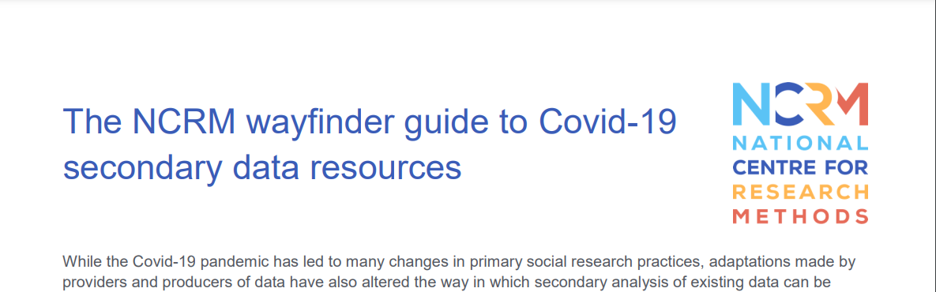




Resources: NCRM Wayfinder Guides
Collaboration with other service providers and data depositors on a guide as part of NCRM’s “Changing Research Methods for Covid-19” Project.
The NCRM Wayfinder guide to Covid-19 secondary data resources –Understanding Society
The NCRM wayfinder guide to moving to secondary data analysis – CDRC, ADR UK, ONS, Joint Biosecurity Centre.

Slide 13
Understanding Society COVID-19 teaching dataset
Developed through a collaboration between the UK Data Service, ISER and Professor Sin Yi Cheung from Cardiff University,
New resource includes a cross-sectional and longitudinal data file.
Simplified documentation
Promotes further reuse of the data
Help make data discoverable in a useful format

Slide 14





Key lessons
Existing networks can facilitate rapid changes
Strong channels of communication are essential
It’s important to understand your expertise
Don’t overlook interdisciplinary collaborations
Think about the next steps

Slide 15

Summary
COVID-19 pandemic required us to adapt quickly
Training events were key to aid data discovery
Resources helped to support changing research processes
Collaboration was essential throughout

Slide 16
Thank you
alle.bloom@manchester.ac.uk

